Slide 1
Data and Ethics
Ritika Bhasker, Data Scientist at DevResults
@mostlyinane
datawrites.co

Slide 2
Why does it matter?
Machine learning is being used to make critical decisions that affect people’s lives
To make better decisions, everyone is collecting huge amounts of data
Decisions made using algorithms aren’t often apparent, or well communicated, to the public
We’re seeing a growing number of data leaks and people are wary about data collection, data retention, and algorithmic decision making.

Slide 3
Why does it matter?
Fairness:
Do our conclusions disproportionately affect certain groups?
Representation:
Does our analysis reinforce existing biases?
Privacy:
What data are we collecting?
Communication:
Does everyone -- from decision makers to those affected by decisions made -- know and understand what just happened?

Slide 4
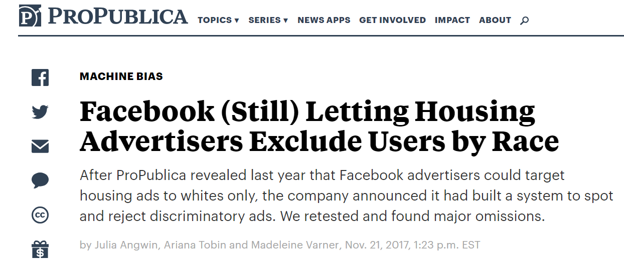
Case studies 1:
Why is this problematic?
How can we fix it?

Slide 5
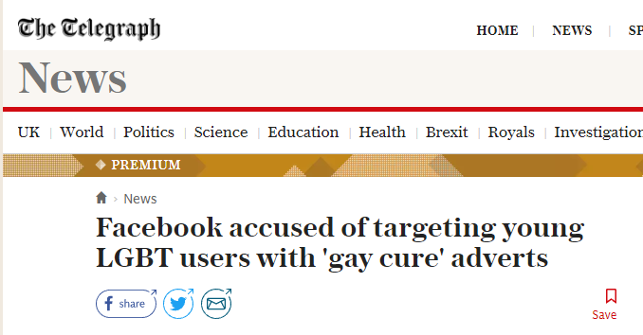
Case Study 2:
Does Facebook have a duty to prevent this?
How would you prevent this?

Slide 6
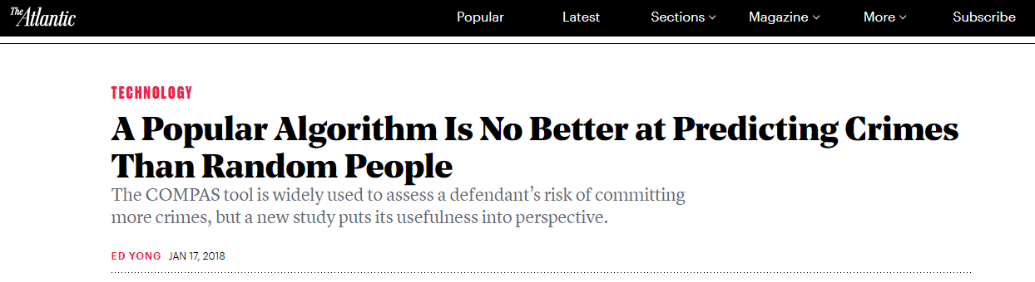
Case Study 3:
Should law enforcement/judges continue using the COMPAS tool?
How can we make the algorithm perform better?

Slide 7
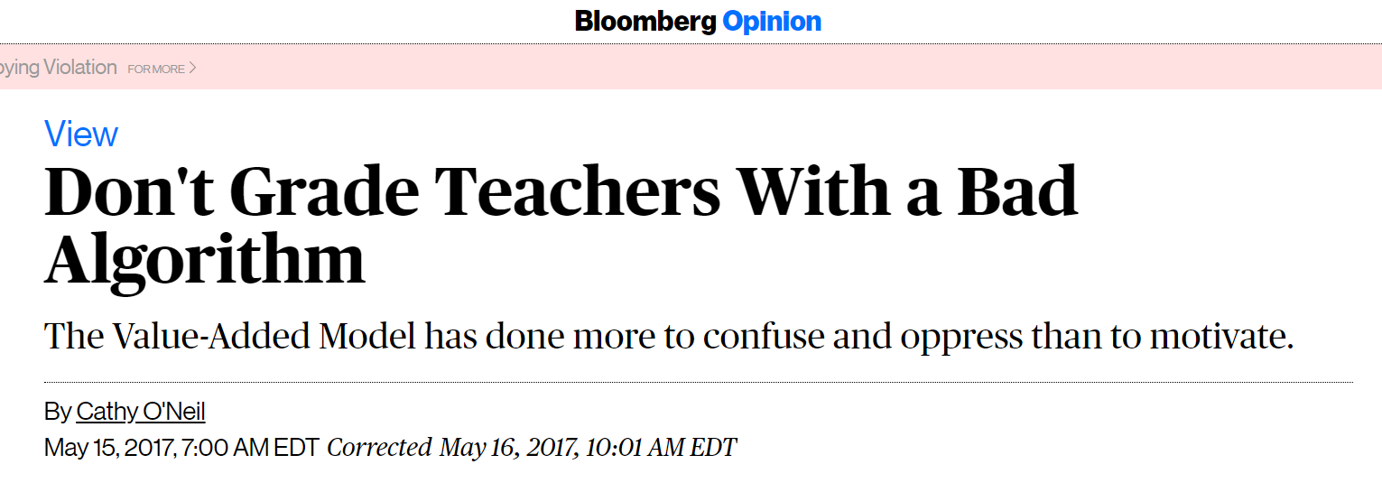
Case Study 4:
How would you fix the algorithm?
Should we be using machine learning here?

Slide 8
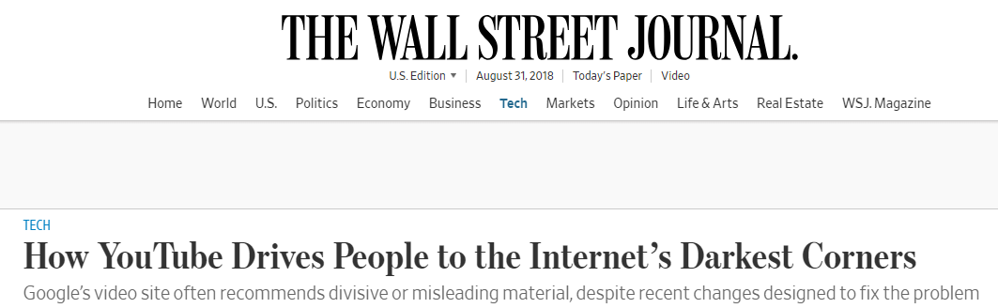
Case Study 5:
Is this a problem YouTube has a duty to fix?
How would you fix this?

Slide 9
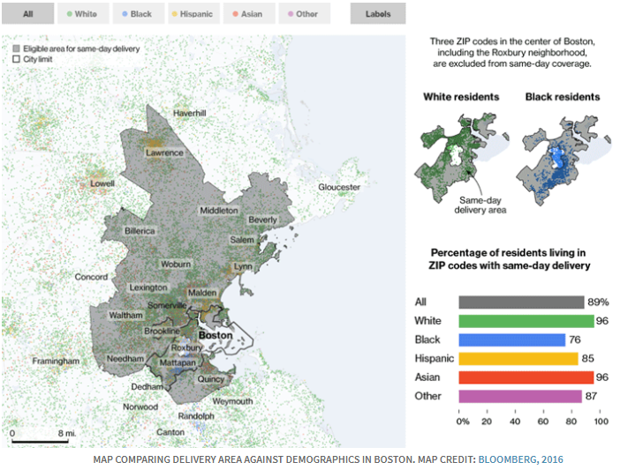
Case Study 6:
What’s the problem here?
How do we fix it?

Slide 10
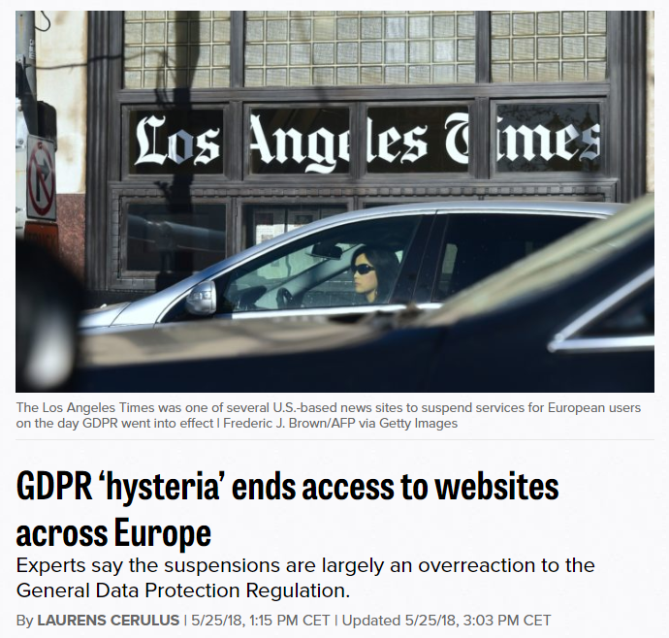
Case Study 7:
Is this a problem?
Why is this a problem?

Slide 11
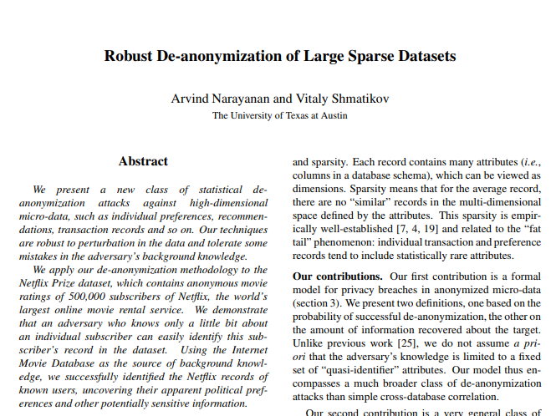
Case Study 8:
Where do we draw the line with anonymity?

Slide 12
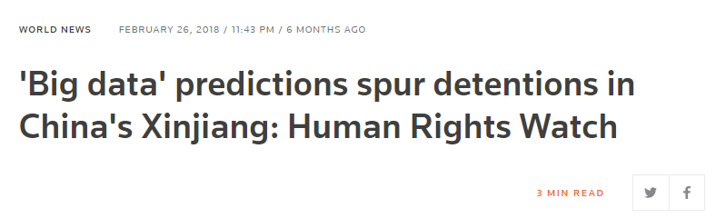
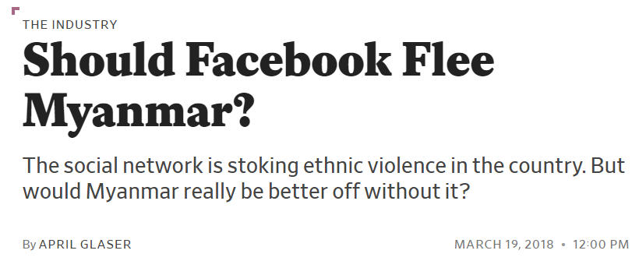
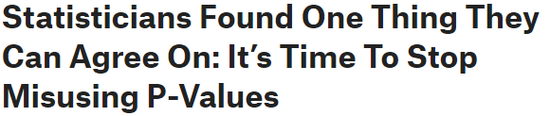
And then there’s:

Slide 13
What approaches could data adopt?
Human rights approach:
ICCPR
UN
Medical approach:
Hippocratic oath
Ethics review board
Behavioural/Social science approach:
IRBs and consent-based approaches
Journalistic approach:
Norms-based approach

Slide 14
Are there laws against this kind of thing?
GDPR
Will be adopted by other governments, too
California Consumer Privacy Act
The most important privacy regulation in the U.S.
Intellectual Property
HIPAA
What else?

Slide 15
What’s the takeaway?
Always question the data
Who created the dataset?
How was the data generated?
What data are you collecting?
Is the data randomly collected? Is it representative?
What features are you retaining and what are you discarding?
What model was chosen and why? What model evaluation metric was chosen and why?
Who is going to use the algorithm (both anticipated and unanticipated)?
Is your data secure? Can PII be revealed in any way?

Slide 16
Further reading:
Weapons of Math Destruction - Cathy O’Neil
Internet of Garbage - Sarah Jeong
Twitter and Teargas - Zeynep Tufekci
Critical questions for big data - danah boyd and Kate Crawford
Big Data, Machine Learning, and the Social Sciences - Hanna Wallach
Ethical Guidelines for Statistical Practice - Committee on Professional Ethics of the American Statistical Association
Journalism as a Professional Model for Data Science - Brian Keegan
Data Science Ethical Framework - UK Cabinet

